Slide 1

Tesla's Strategic Shift:
Harnessing Demand Forecasting for Enhanced Operational Efficiency

Slide 2

DISCUSSION POINTS
Today’s Tesla
Integrate demand forecasting solutions recommendations and benefits
Demand forecasting solutions Analysis
Risks
Adoption Analysis

Slide 3

Today’s Tesla
Tesla combines a unique sales strategy with dedicated service and expansive charging infrastructure.
Emphasizing on both hardware and software, Tesla leads in innovation and sustainable energy solutions.
Tesla's self-sustained ecosystem, encompassing vehicles to energy storage, sets them apart from competitors.
In the years 2022-2023, as a significant number of competitors entered the market, Tesla's market share and profitability experienced a decline.
Notes:
Tesla, an innovation-driven tech giant, specializes in electric vehicles, solar energy, and storage solutions. With a unique direct-to-consumer sales approach, expansive Supercharger network, and unmatched vehicle performance, the company stands out in the global market. Their emphasis on R&D, particularly in digital technology and sustainable energy, reinforces their leading position in the industry. ((Tesla, 2023)
Tesla targets a diverse clientele, from mid-range consumers to those seeking luxury vehicles rivaling Porsche or Ferrari, and even extends to commercial sectors offering greener transport solutions. Tesla's value proposition lies in its eco-friendly solutions, boasting high-performance, design, efficiency, long-range capabilities, and convenient or even free charging. Apart from their vehicles, Tesla also provides home batteries and solar panels to residential and business clients, offering energy solutions and even financial services via system and component sales to other manufacturers. At its core, Tesla prioritizes the customer experience, evident in its direct-to-customer model bypassing traditional dealerships. The company enhances this experience by allowing online vehicle customization and ordering, and by investing in its extensive charging network. Ultimately, Tesla's brand resonates as a symbol of luxury, technology, innovation, and environmental consciousness. (Daniel, 2023)

Slide 4
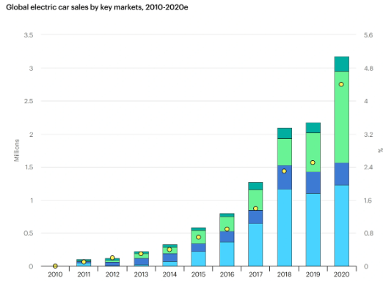
S | Strengths: Impressive Hiring Strategy Strong Brand Value and High Market Capitalization Phenomenal Organizational Structure Unique Brand positioning and Superb Marketing Strategy Strong Innovative Capacity Almost Near-total Market Dominance
W | Weaknesses: Frequent Manufacturing Delays Setting Overly Optimistic Targets The Cost of Products
O | Opportunities: Introducing Its Products to New Markets Improving the Affordability of Their Vehicles Improving Their Autonomous Driving Technology In-house Battery Production Maintaining Its Reputation as the Champion of Innovation
T | Threats: Increasing Competition from Other Top Automakers The Uncertainty Surrounding Rare Earth Metals The Legal Intricacies of Self-driving Vehicles Changing Government Policy and Public Opinion on Green Energy
Notes:
The SWOT analysis highlighted emphasizes pivotal areas where Tesla should focus its attention. Historically, Tesla has showcased an impressive hiring strategy, fortified its brand value with significant market capitalization, and established a nearly unparalleled market dominance. Their unique brand positioning, complemented by a phenomenal organizational structure and innovative capabilities, has solidified their standing in the automotive world. However, the increasing global shift towards electric vehicles has put Tesla in a challenging position. The chart on the right shows that the electric vehicle market has been steadily growing this year, with a significant increase in user demand. While the company has opportunities in introducing products to new markets, advancing autonomous technology, and in-house battery production, it grapples with frequent manufacturing and delivery delays. (Daniel, 2023) Such operational hiccups often lead to an inability to accurately predict user demand.
Image Credit:
EV sales grew from less than 1% of total vehicle sales a decade ago to more than 4% today. (Josh, 2022)

Slide 5
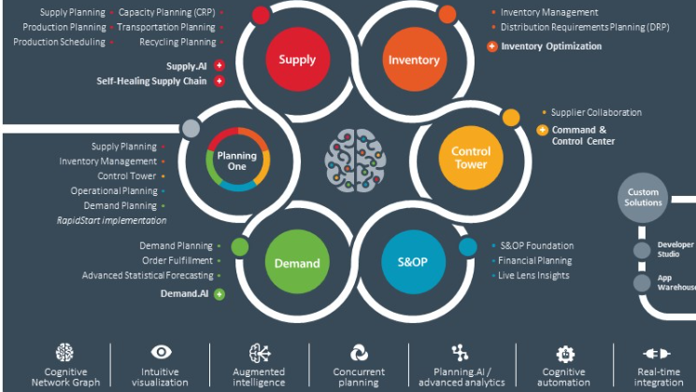
Notes:
Tesla's rapid growth has underscored a crucial operational gap: the lack of accurate demand forecasting. Addressing this, we recommend adopting Demand Forecasting Solutions. This technology integrates diverse data sources and employs predictive analytics to offer a precise prediction of market demand. It will empower Tesla's decision-makers to anticipate market needs better, optimizing production and reducing delivery delays. Envision a near-future where Tesla's production is in perfect harmony with consumer demand, eliminating costly overproduction and meeting delivery promises consistently. This is the promise of demand forecasting solutions. Our reputation will once again be elevated, capturing the market.
Image Credit:
Demand forecasting solutions (Kinaxis, 2023)

Slide 6
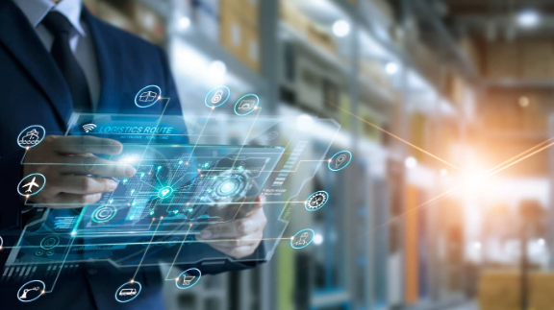
Notes:
To achieve our technological vision, here is the technical support we require:
To ensure the smooth operation of Demand Forecasting Solutions, we need a robust cloud platform. Fortunately, this requirement has already been met. Our collaboration with Microsoft's Azure cloud platform provides us with a stable and scalable computing environment, ensuring the efficiency of data processing and analysis.
Furthermore, to further enhance forecasting and planning, we also need Demand Planning Software. This software will assist us in integrating and analyzing data, thus providing more accurate market demand forecasts. To achieve this, we can consider partnering with several leading companies in the industry to provide us with the most suitable software solutions that meet our needs.
Image Credit:
Demand Planning & Forecasting Software (ToolsGroup, 2023)

Slide 7
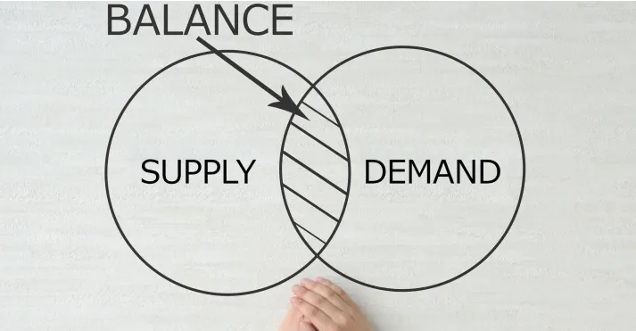
USE:
Notes:
Adopting Demand Forecasting Solutions will significantly streamline Tesla's operational efficiency. The primary use, of course, is to provide accurate demand predictions, reducing the disparities between production and actual market demand. By integrating diverse data sources and utilizing predictive analytics, Tesla can anticipate production needs, drastically minimizing manufacturing and delivery delays - a recurrent issue in recent years. Beyond this immediate application, the technology can also be used to analyze trends, enabling Tesla to proactively adjust its product offerings and innovations in line with anticipated market shifts. (Michigan State University, 2023) Moreover, by reducing the operational costs linked to overproduction or underproduction, Tesla can allocate resources more effectively, meeting compliance requirements and mitigating associated risks.
Image Credit:
What Is Demand Planning & How Is It Important to Supply Chain? (Michigan State University, 2023)

Slide 8

Competitive Uses and Benefits:
Implementing Demand Forecasting Solutions strengthens Tesla's image of innovation and customer focus.
Accurate demand forecasting sets Tesla apart from competitors in the fast-evolving electric vehicle industry.
Tesla's reputation for reliability is enhanced by meeting market demand accurately.
Better demand understanding enables Tesla to seize new opportunities, including product expansion or market entry.
The technology's value transcends mere operational efficiency; it offers strategic insights.
Tesla's use of this technology reaffirms its position not just as a car maker, but as an industry-forward thinker.
Tesla leverages technology to advance its mission of transitioning the world to sustainable energy.
Notes:
From a competitive standpoint, implementing Demand Forecasting Solutions would fortify Tesla's brand promise of innovation and customer-centricity. In an industry rapidly shifting towards electric vehicles, the ability to accurately meet market demand will distinguish Tesla from competitors, enhancing its reputation for reliability. Furthermore, understanding market demand better will allow Tesla to tap into new opportunities, potentially expanding its product range or entering new markets more confidently. The forecasting technology doesn't merely enhance operational efficiency; it provides Tesla with data-driven insights that can shape its strategic direction. This positions Tesla not just as a car manufacturer but as a proactive market leader, using technology to drive its mission of accelerating the world's transition to sustainable energy. (Rachel, 2023)

Slide 9
Why Demand Forecasting Solutions
Demand Forecasting Solutions
Legacy Demand Prediction
Integrates diverse data sources
Employs predictive analytics
Offers high accuracy
Suitable for Tesla's growth
Provides consistent & reliable results
Displaces legacy systems efficiently
Enhances production & delivery timelines
Limited data source integration
Relies on historical data
Moderate accuracy
May not scale with Tesla's expansion
Prone to manual errors
Requires manual processes
No guarantee of reducing inefficiencies
Notes:
In the automotive landscape where innovation is synonymous with survival, Tesla's shift from Legacy Demand Prediction to advanced Demand Forecasting Solutions isn't just timely—it's crucial. The former's reliance on limited data integration and historical figures cannot keep pace with Tesla's meteoric rise and the industry's evolving dynamics. Demand Forecasting Solutions, on the other hand, encapsulate a broader spectrum of data sources, harness the power of predictive analytics, and guarantee higher precision. As Tesla seeks to balance its impressive growth trajectory with operational efficiency, it is evident that the future lies in adopting solutions that not only scale with the company's ambitions but also diminish manual errors, ensure consistent results, and streamline production and delivery timelines. By displacing outdated systems and practices, Tesla positions itself to meet market demands with unmatched agility and foresight, reaffirming its commitment to excellence and customer satisfaction. (Abby, 2022)

Slide 10
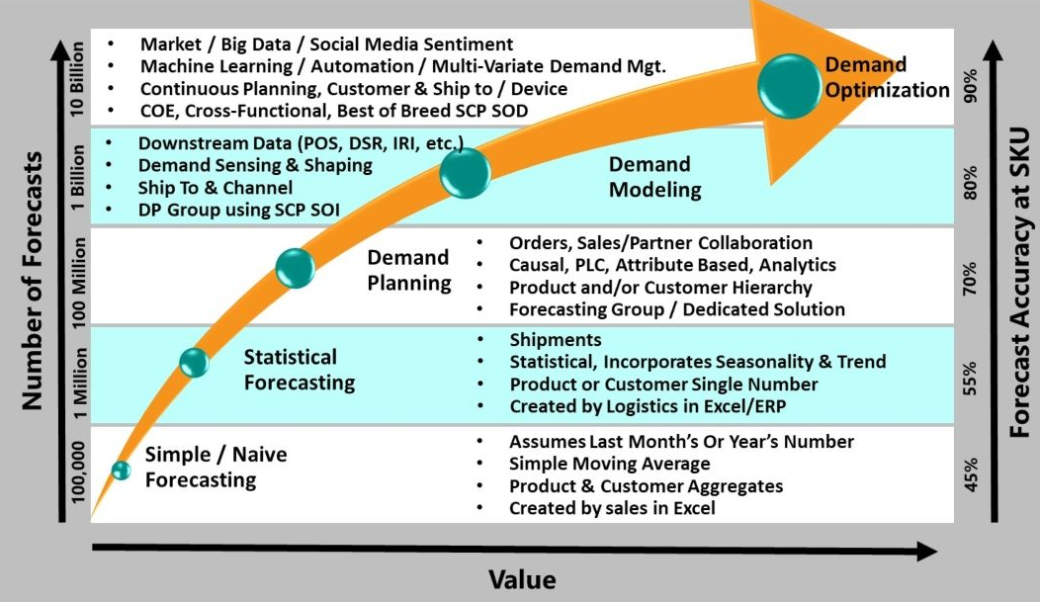
Notes:
The technology in question, Demand Forecasting Solutions, has reached a mature stage of its life cycle. Recognizing its position on the reality curve, we believe it has moved past the initial hype and uncertainty and is now showing consistent and reliable results in varied real-world applications. Many businesses, especially within the e-commerce and retail sectors, have already integrated such solutions with significant success in predicting market needs. A particular strength lies in its ability to integrate diverse data sources and employ predictive analytics, leading to enhanced accuracy. Concerning the companies developing this technology, a majority have proven stability and longevity in the market. (Logility, 2022)
The adoption of Demand Forecasting Solutions may lead to a phased displacement of certain legacy systems or manual processes previously employed for demand prediction. Given Tesla's current challenges in production and delivery timelines, the technology stands to bring rapid positive disruption, reducing the operational inefficiencies. The pace of displacement will be contingent on how smoothly the technology integrates with existing systems and processes.
Image Credit:
Demand Optimization Maturity Curve (Logility, 2022)

Slide 11
IMPACTS
Systemic Transformation: Tesla will undergo a large-scale migration to a new data management system.
Data Sharing and Security: AI-driven forecasting requires enhanced data sharing, necessitating strict metadata locks for privacy.
Standardization Challenges: The advanced nature of the solution might limit Tesla's options due to a lack of industry standards.
Computational Costs: Increased reliance on active machine learning will demand greater computational power, leading to higher costs.
Notes:
Integrating this technology into Tesla's existing IT infrastructure may pose initial challenges. There would be a need to ensure compatibility with current systems, and a period of transition may entail training personnel and ensuring data privacy and security measures are not compromised.
Furthermore, as Tesla continues to grow and evolve, adopting such a technology could guide future technology decisions, ensuring systems are built to be complementary. To mitigate potential risks, partnering with established IT service providers and ensuring rigorous system testing before full deployment would be essential.
Over the next five years, we anticipate the technology will undergo enhancements in terms of machine learning capabilities, data processing speeds, and integration features. This evolution could mean that Tesla will benefit from even more accurate forecasting, but without control over its evolution, there might be added costs associated with updates or modifications.
While there are other technologies and manual strategies that can be employed for demand forecasting, none match the accuracy, efficiency, and integration capabilities of the Demand Forecasting Solutions. Alternative technologies might offer components of the solution but may not provide the holistic approach that this technology promises. Given Tesla's expansive growth and the volume of data it handles, the chosen technology stands out as the most viable, future-proof solution, offering the best balance of cost, risk, and benefit.

Slide 12

RISKS
Organizational Readiness and Adaptability: Tesla's growth could pose challenges in staff adaptability and cultural alignment with the new Demand Forecasting Solutions.
External Relationship Dynamics: The new technology might strain Tesla's relationships with suppliers and dealers due to increased third-party data dependencies.
Competitive Landscape Alteration: Tesla's adoption of the technology could standardize demand forecasting in the industry, potentially commoditizing this aspect of the electric vehicle sector.
Notes:
Tesla's rapid growth has made its structure and processes more complex. The integration of Demand Forecasting Solutions may further complicate operations if the staff and culture are not adaptable to this change. The unique organizational culture and the management style of Tesla could face resistance or friction during deployment. (Dorota. 2023)
The adoption of this technology might shift the dynamics of Tesla's relationship with external stakeholders, especially suppliers and dealers. Given the direct-to-consumer model, Tesla’s reliance on third-party data sources and collaborations could be seen as a potential threat by some partners.
While the adoption could streamline operations internally, externally, it might level the playing field. Competitors may view Tesla's move as a standard, potentially accelerating their adoption of similar technologies. This could lead to potential commoditization in the electric vehicle sector concerning demand forecasting. (Dorota. 2023)

Slide 13

IMITIGATION
Stakeholder Involvement: Engage all stakeholders through communication and feedback sessions to ensure seamless adoption.
Change Management: Implement a tailored change management plan, with training and pilot programs, addressing Tesla's unique needs.
Resource and Capability Management: Utilize Azure collaborations and consider outsourcing to bolster IT capabilities and support during the transition.
Pace of Deployment: Opt for a phased deployment to identify and address challenges early on.
Governance Structure: Form a governance body to guide the integration in line with Tesla's goals.
Notes:
Ensuring all key stakeholders, both internal (employees, management) and external (partners, suppliers), are informed about the change. Regular communication, workshops, and feedback sessions can foster trust and ensure smooth adoption.
Instituting a rigorous change management plan that considers the unique aspects of Tesla's culture and business operations. This includes continuous training, creating pilot programs for a phased rollout, and having a dedicated team to address any hiccups during the transition.
Leveraging the existing collaboration with Microsoft's Azure, Tesla can ensure that they have the necessary IT capabilities for a seamless transition. Outsourcing certain aspects of the integration, especially training and support, could alleviate the internal burden.
Instead of a full-fledged rollout, adopting a phased deployment can help in identifying potential problems early on. Starting with a single facility or department and gradually expanding can mitigate widespread disruptions.
Establishing a governance body, consisting of leaders from key departments and external consultants, can provide direction, set priorities, and ensure that the integration aligns with Tesla's overarching goals. (Steven, 2021)
In summary, while the adoption of Demand Forecasting Solutions presents notable risks, with strategic mitigation approaches tailored to Tesla's unique position and structure, the potential rewards far outweigh the challenges.

Slide 14
Adoption Analysis: Goals
Enhanced Operational Efficiency: By accurately forecasting demand, Tesla can optimize production and reduce delivery delays, resulting in increased customer satisfaction.
Strategic Competitive Advantage: As electric vehicle market competition intensifies, having an edge in demand prediction can keep Tesla ahead of its competitors, ensuring that the company can meet market demand efficiently.
Future Business Evolution: The technology aligns with Tesla's goals of innovation, making it easier for the company to adapt to changing market dynamics, evolving customer preferences, and potential business model shifts.
Notes:
By being able to accurately predict market demand, Tesla not only streamlines its production processes but also drastically reduces delivery timelines, ensuring that customers receive their vehicles as promised. Such punctuality and efficiency are pivotal in fostering customer loyalty and trust. Furthermore, in a market where electric vehicles are becoming increasingly ubiquitous, being ahead in demand prediction can offer Tesla a distinct competitive advantage. It allows the company to anticipate market shifts and adjust production rates accordingly, ensuring that they're neither overproducing nor facing product shortages. Lastly, this technology isn't just about the present – it's a forward-looking approach. Tesla's mission has always been grounded in innovation, and adopting such cutting-edge solutions aligns perfectly with the company's vision for the future. (Pacemaker, 2023) As the automotive landscape continues to evolve, having the capability to adapt quickly to changing consumer preferences and market dynamics will be crucial. The Demand Forecasting Solutions, in essence, offers Tesla the agility, precision, and foresight to remain a market leader in the years to come.

Slide 15
Adoption Analysis: Costs
Initial Integration Cost: Estimated at $3 million, covering the licensing of the technology, initial setup, and integration into Tesla's current IT infrastructure.
Training and Support: Roughly $1 million for continuous training programs, workshops, and support during the initial phase.
ROI: By reducing overproduction and ensuring consistent delivery timelines, Tesla can potentially save an estimated $10 million annually. Further, enhancing customer trust through reliability can result in increased sales, leading to a ROI in less than two years.
Risks of Adoption: Allocated $500,000 for pilot programs, phased rollouts, and dedicated teams to address potential issues. If risks materialize, additional costs might be incurred in terms of PR management and operational adjustments.
Other Approaches: Manual Forecasting: While traditional methods exist, they lack the accuracy, efficiency, and data integration capabilities of the proposed solution. Given Tesla's data volume and market dynamics, Demand Forecasting Solutions offers the best balance of cost and benefit.
Relative Value：Adopting this technology is of high importance, especially when juxtaposed with other IT activities. It directly addresses a current operational gap, and its integration will reinforce Tesla's position in the market.
Notes:
Adoption of the Demand Forecasting Solutions presents a strategic opportunity for Tesla, with an estimated ROI in less than two years, given the potential savings of around $10 million annually. The initial integration and training costs, while significant, are outweighed by the potential gains in optimizing production and enhancing customer trust. Furthermore, in the electric vehicle landscape, Tesla's unique position demands precision in demand forecasting. (Netstock, 2023) While peers like Nio might have a similar approach due to their growth trajectory, traditional players like Ford may integrate differently due to their legacy systems. Meanwhile, Volkswagen, given its global reach, might adopt a more region-specific strategy, highlighting the need for Tesla to maintain a holistic approach in its technological integration.

Slide 16
THANK YOU! Do You Have Any Questions?

Slide 17
WORK CITY
Tesla, “Annual Report & Webcast”, 2023, https://ir.tesla.com/#other-documents-events.
Daniel, Pereira, “Tesla Business Model” July 6, 2023, https://businessmodelanalyst.com/tesla-business-model/#:~:text=The%20Tesla%20business%20model%20operates,easily%3A%20Tesla%20or%20Elon%20Musk%3F.
Josh, Howarth, “10 Important Auto Industry Trends (2023-2025)”, December 15, 2022, https://explodingtopics.com/blog/auto-industry-trends
Kinaxis, “Meet the Only Concurrent Planning Platform”, January 23, 2023, https://www.kinaxis.com/en/solutions/platform
ToolsGroup, “Demand Planning & Forecasting Software”, March, 14, 2023, https://www.toolsgroup.com/solutions/demand-forecasting-planning/
Michigan state university, “How Demand Planning Can Improve the Supply Chain”, July 26, 2023, https://www.michiganstateuniversityonline.com/resources/supply-chain/how-demand-planning-improves-supply-chain/
Abby, Jenkins,”Demand Forecasting: Everything You Need To Know”, September, 2022, https://www.netsuite.com/portal/resource/articles/inventory-management/demand-forecasting.shtml

Slide 18
Logility, “Demand Optimization Maturity Curve”, October 22, 2022, https://www.logility.com/blog/demand-optimization-maturity-curve/
Rachel, Hand, “What is Demand Forecasting? Importance and Benefits of Forecasting Customer Demand” October 13, 2023, https://www.shipbob.com/blog/demand-forecasting/
Dorota, Owczarek, “What Makes Demand Forecasting Difficult? Navigating the Supply Chain Forecasting Challenges”, April 22, 2023, https://nexocode.com/blog/posts/supply-chain-forecasting-challenges/
Steven, Calhoun, “Demand Forecasting Problems and How to Solve Them”, February 5, 2021, https://www.veryableops.com/blog/demand-forecasting-problems
Pacemaker editorial office, “Why Demand Forecasting is Crucial for Companies”, July 4, 2023, https://pacemaker.ai/blog/why-demand-forecasting-is-crucial-for-companies
Netstock, “Calculate your ROI”, October 17, 2023, https://www.netstock.com/

